Slide 1
Crowd Funding Data Insight
Werner Chao
March 26, 2017

Slide 2
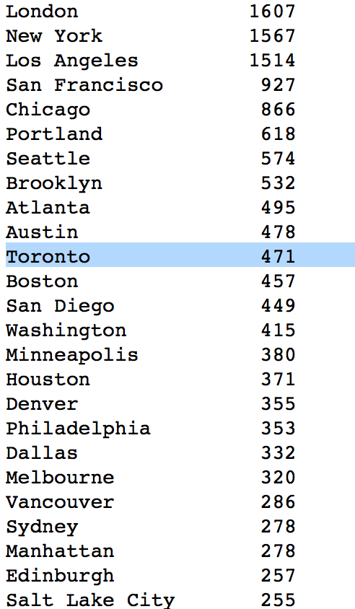
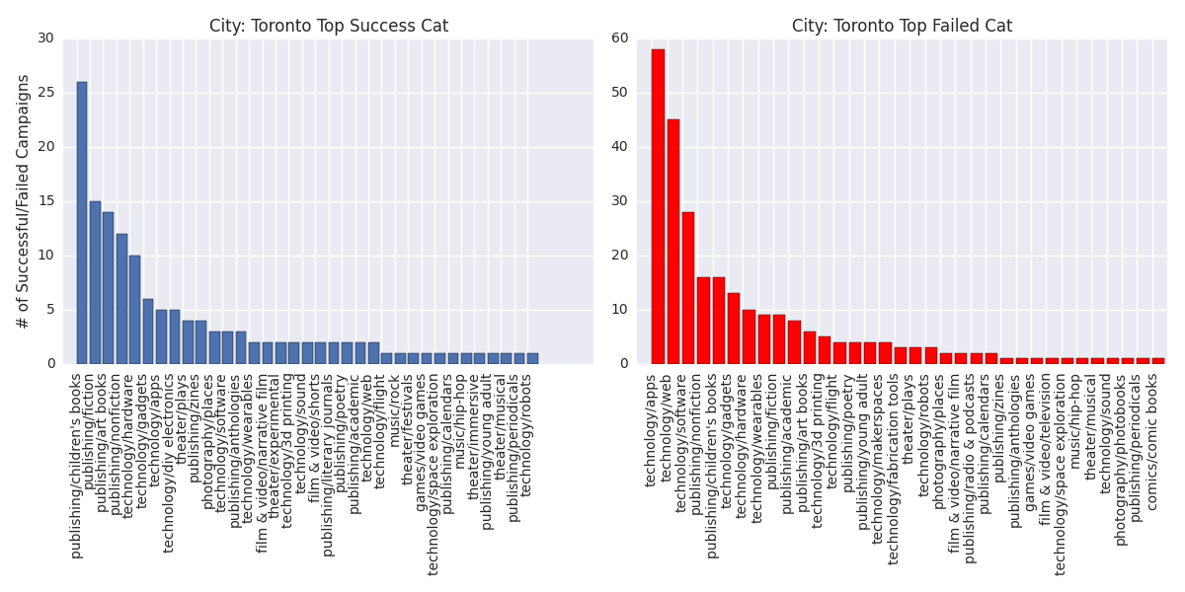
Where Does Toronto Stand in the World?

Slide 3
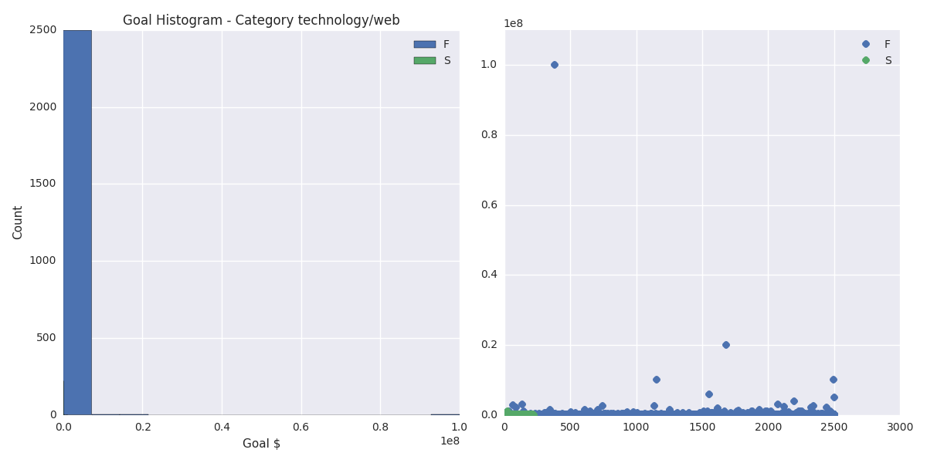
Category: technology/web # of Failed campaigns: 2502 # of Successful campaigns: 222

Slide 4
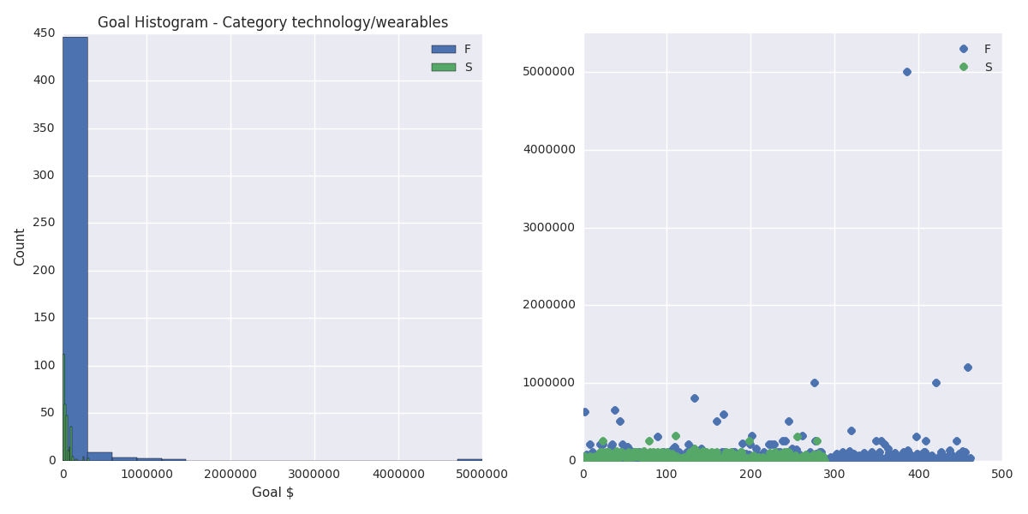
Category: technology/hardware # of Failed campaigns: 1669 # of Successful campaigns: 1078

Slide 5
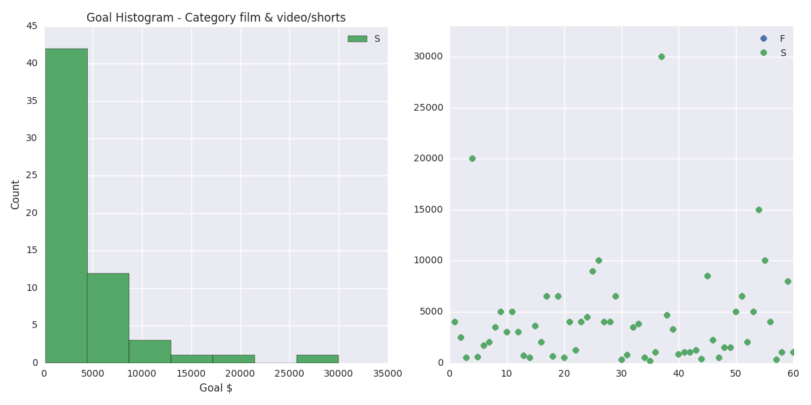
Category: film & video/shorts # of Failed campaigns: 0 # of Successful campaigns: 60

Slide 6
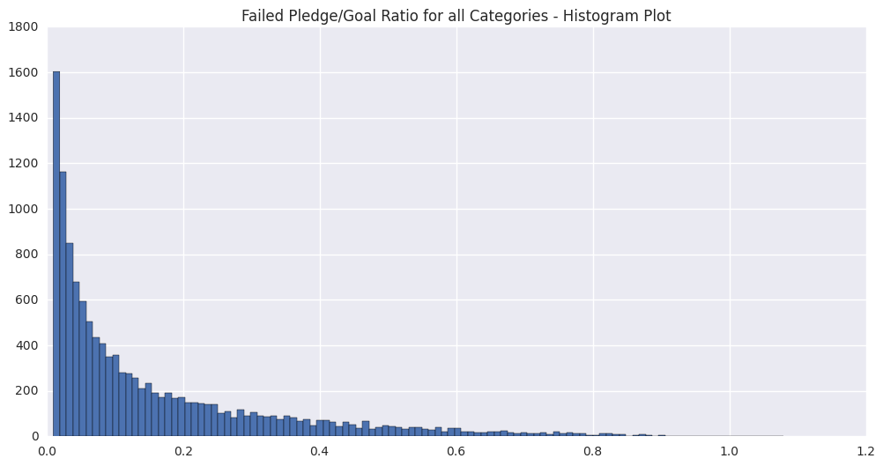
Failed Pledge/Goal Ratio

